Slide 1
Notes:
This template provides guidance for creating a Maturity Analysis Presentation to present the results of a Maturity Assessment. Update the examples provided to fit your specific assessment. Be sure to remove irrelevant content to your specific assessment before making your presentation or delivering to stakeholders.

Slide 2


<Assessment Type> Maturity Analysis
<Company Name>
<Project Name>
Presenter’s Name
Presenter’s Title
Organization, Division or Business Unit
Month 00, 2014
Note: The speaker notes for this slide include detailed instructions on how to customize this Title Slide with your own picture.
Tip! Remember to remove this text box.
Notes:
This is a Title Slide with Picture slide ideal for including a picture with a brief title, subtitle and presenter information.
To customize this slide with your own picture:
Right-click the slide area and choose Format Background from the pop-up menu. From the Fill menu, click Picture and texture fill. Under Insert from: click File. Locate your new picture and click Insert.

Slide 3
Executive Summary
<Enter the most important findings and recommendations.>

Slide 4
Maturity Assessment Scope and Purpose
<Describe the scope and purpose of the assessment.>

Slide 5
Assessment Approach
<Enter Highlights of the Assessment Approach, for example, what kind of resources were used; interviews, tooling, etc.>

Slide 6
<Assessment Type> Maturity Model Domains Domain – A Collection of Related Capabilities
<Additional Details>
Architecture
Business
&
Organizational
Disciplines
Strategy
Infrastructure
Organization
Information
Governance
Operations
Technology
Dominated
,
Projects
,
Administration
Portfolios
&
&
Services
Management
Notes:
This is an example of a Domain Model for a SOA Maturity Assessment. The description follows:
Business & Strategy - Contains capabilities that provide the high-level constructs that allow the SOA initiative to proceed. This includes such things as business motivation, expected benefits, guiding principles, expected costs, funding model, etc.
Architecture – Contains capabilities concerning the definitions of the overall architecture and guidelines for various practitioners to ensure adherence to the architecture.
Infrastructure – Contains capabilities concerning the service infrastructure and tools that provide the technical foundation for the SOA initiative.
Information – Contains capabilities concerning the information aspects of SOA, e.g., providing Information as a Service (IAAS). This includes shared data models, message formats and schemas, master data management, content management, etc.
Projects, Portfolios & Services – Contains capabilities concerning the planning and building of services and the service usage guidelines of service consumers.
OA&M – Contains capabilities concerning the post deployment aspects of solutions based on a service-oriented architecture i.e. the Operations, Administration, and Management aspects of SOA.
Organization – Contains capabilities concerning the development of corporate competency around SOA including the organizational structure and skills development.
Governance - Contains capabilities concerning the governance structures and processes that support and guide the SOA efforts. Maturity and adoption of an adequate amount of governance is a leading indicator of the overall SOA success.
Update the presentation with a Maturity Model relevant to your assessment.

Slide 7
<Assessment Type> Maturity Model Domains
<Talked to…from…departments, timeframe, etc.>
Architecture
Business
&
Organizational
Disciplines
Strategy
Infrastructure
Organization
Information
Governance
Operations
Technology
Dominated
,
Projects
,
Administration
Portfolios
&
&
Services
Management
Notes:
This slide is a visualization of the scope of the assessment. Update the bullets with the details of who was interviewed, from which departments, and within what timeframe. It should visualize the actual basis on which the assessment was made. Too few people, or the wrong people will provide less validity for the assessment – but having the right people listed, makes the results more valuable to the audience.

Slide 8
Maturity Levels
Level 5 - <Description>
Level 4 - <Description>
Level 3 - <Description>
Level 2 - <Description>
Level 1 - <Description>
Level 0 - <Description>
OPTIMIZED
- 5 -
MANAGED
- 4 -
SYSTEMATIC
- 3 -
OPPORTUNISTIC
- 2 -
AD HOC
- 1 -
NOTHING
- 0 -

Slide 9
The Results

Slide 10
Spider Graph of Current Maturity and Adoption
 | Current
Domains | Maturity | Adoption
Business & Strategy | 0,83 | 1,00
Architecture | 2,35 | 2,45
Infrastructure | 1,72 | 2,22
Information | 1,00 | 1,22
Operations, Administration & Management | 0,00 | 0,00
Projects, Portfolios & Services | 1,29 | 1,57
Organization | 1,17 | 2,00
Governance | 2,20 | 2,70
Notes:
This is a graph that visualizes the current maturity and adiption on the different domains – the example is from the Oracle SOA Maturity Assessment tool.

Slide 11
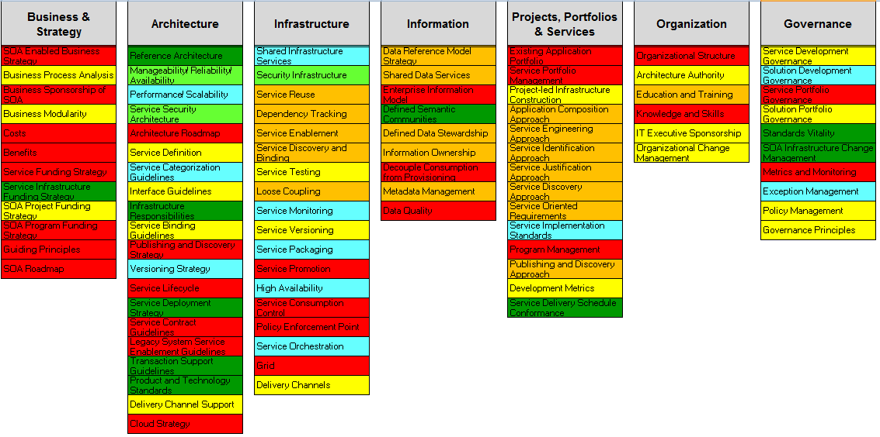
Assessment Heat Map – Assessment per Capability
Legend
Optimized
Managed
Systematic
Opportunistic
AdHoc
No SOA
Notes:
This Heat Map visualizes the most mature and the most lagging capabilties per domain – the example is from the Oracle SOA Maturity Assessment tool.

Slide 12
Conclusion
Highest Maturity is in the <List Domains> Domains
<Additional Findings/Details>
<Domain> is the Lowest
<Additional Findings/Details>

Slide 13
Conclusion per Domain
<Domain Name>
Strong:
<List Strong Parts>
Challenges:
<List Challenges>
Notes:
Walk through each domain, and list the strong parts, and where there are challenges.
Repeat this slide for each domain.

